Slide 1
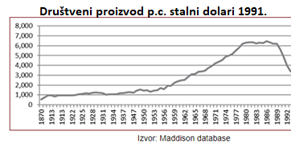
The economic trajectory of the Yugoslav-space:
growth, welfare, and socio-economic prosperity/wellbeing over the past century
prof Danica Popović
University of Belgrade, Faculty of Economics
Copenhagen Business School (CBS)
November 11, 2021.

Slide 2
The economic trajectory of the Yugoslav space: mind the data!!!!
SLO
CRO
SER
MAC
MON
BIH
Izvor: Gligorov, 2012.

Slide 3
MADDISON VS. REALITY
SLO
CRO
MON
SER
MAC
BIH

Slide 4
How logg will it take*
How long will it take?
These messages are frequently repeated by IMF, WB....
2017- Ekaterina Vostroknutova, vodeći ekonomista Svestske banke, pre dve nedelje, na predstavljanju godišnjeg ekonomskog izveštaja za zapadni Balkan.

Slide 5
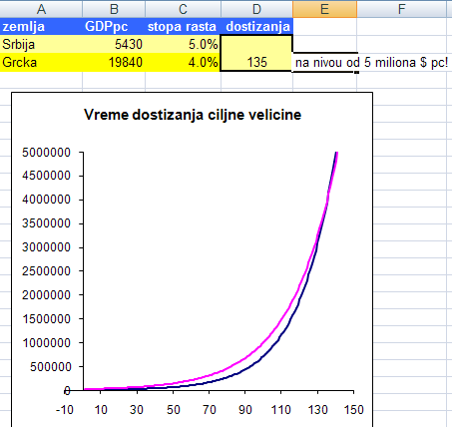

Slide 6
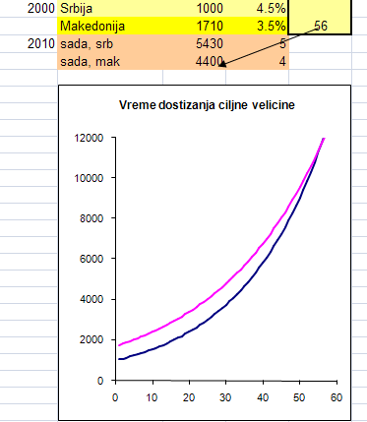
6000
5800
2017
Ako duplira rast, Srbija će za 20 godina stići samu sebe
What growth rate would leave us at the same distance, if that county grows by ....% annualy?
results –
Serbia needs 5% annual growth rate to keep the same distance from the EU,
when EU grows by 1% annually

Slide 7
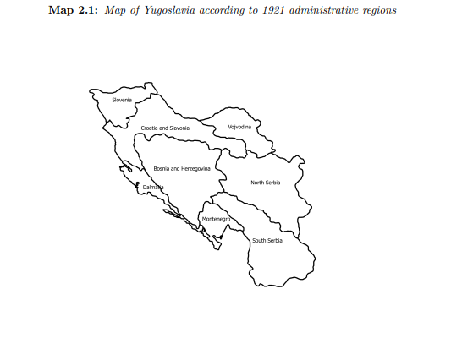
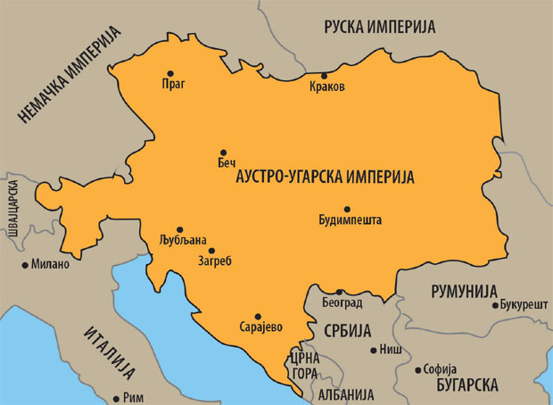
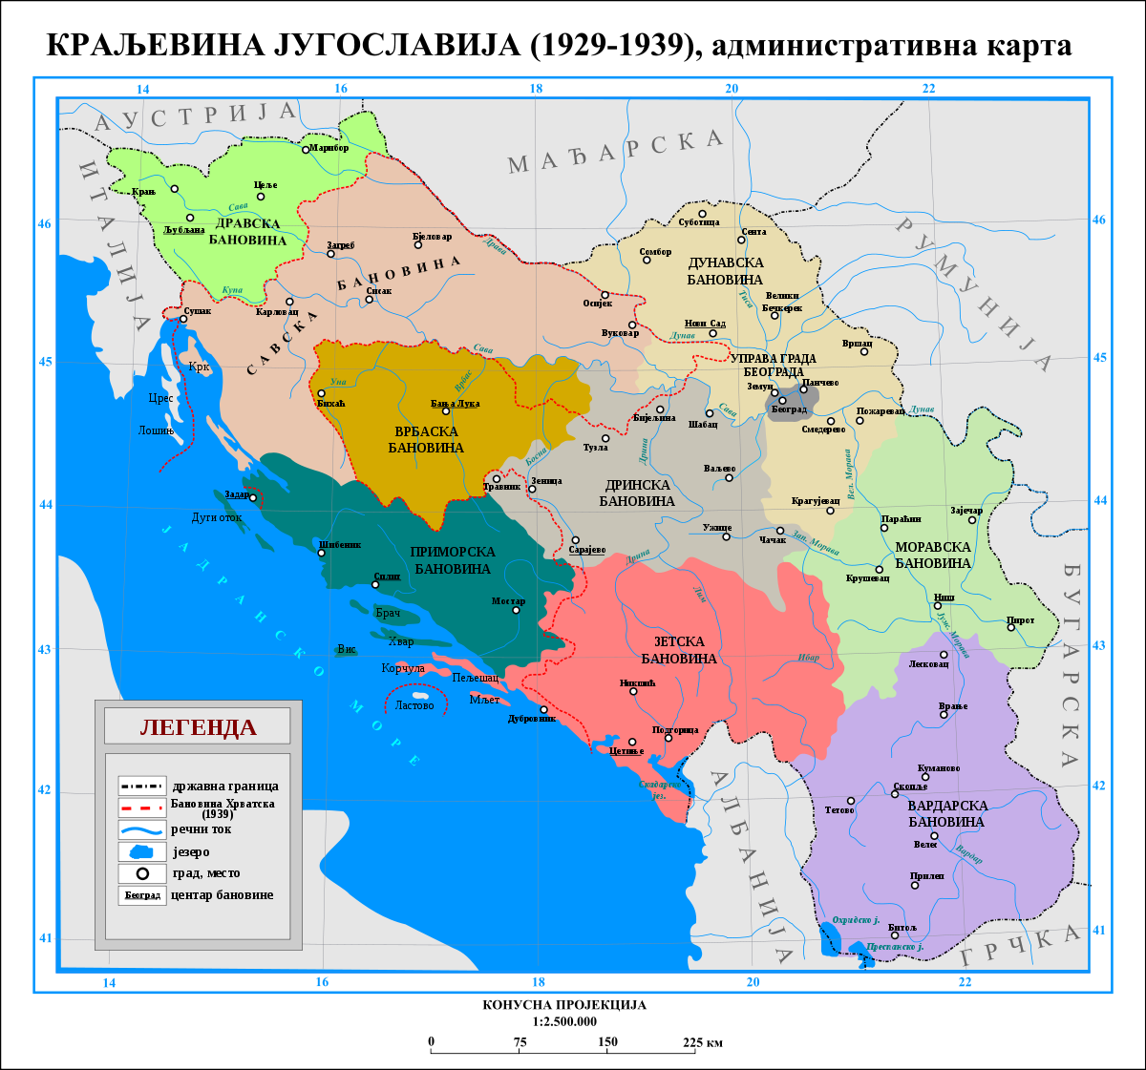
Unification of tax administrations
The Gold Exchange Standard as of 1918
Source: Stefan Nikolic, Ph. D, New Economic History of Yugoslavia, 1919 – 1939,
University of York,2016
Notes: The eight administrative regions were: Bosnia-Herzegovina, Croatia-Slavonia, Dalmatia,
Montenegro, South Serbia, North Serbia, Slovenia and Vojvodina.
Sources: map of mainland Yugoslavia based on map from [Kraljevina Jugoslavija, 1932].

Slide 8
NI – OUTPUT - growth
Strong investment activity on the start
Mostly due to gold standard and huge money inflow
Most firms and banks started with capital financed by invoices and credit
Conjuncture started in 1919 in most parts, in Serbia it started in 1920.
Most industries between two wars were innitiated in the very start
1923–1925. fiscal consolidation and dinar appreciation
from 1928 to 1934, wholesale prices fell by 40.5%,
Economic crisis – 1929-1933
Bancruptcy - 1932
Great Depression
Average growth rate 2,2%
. Serbia/Yugoslavia: from 1884 to 1940 Branko Hinić, Ljiljana Đurđević and Milan Šojić, National Bank of Serbia

Slide 9
PRICES – strong deflation
, from 1928 to 1934, wholesale prices fell by 40.5%,
Great Depression emerged along
Great Depression
Serbia/Yugoslavia: from 1884 to 1940 Branko Hinić, Ljiljana Đurđević and Milan Šojić, National Bank of Serbia

Slide 10
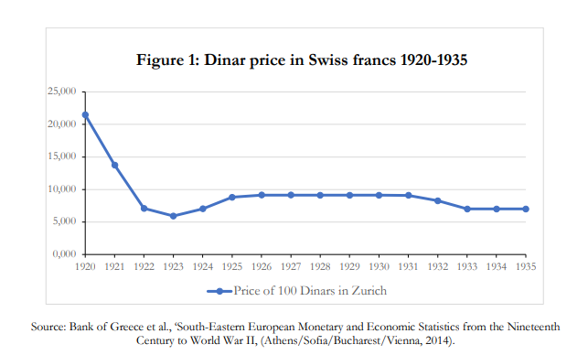
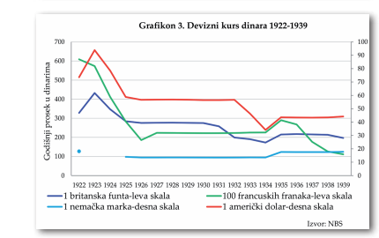
GOLDEN STANDARD
Currency unification 1920.
a wish for foreign borrowing -the main economic rationale for joining the gold standard
Dinar as a legal tender (replacing the former crown of the Habsburg Monarchy– 4:1)
The main isuue was - redistribution
The two areas were trying to maximise their stance
Currency unification left deep political wounds

Slide 11
WAGES
As seen in Figure 12, prices fell more rapidly than nominal wages over the crisis years 1930–1934.
Serbia/Yugoslavia: from 1884 to 1940 Branko Hinić, Ljiljana Đurđević and Milan Šojić, National Bank of Serbia

Slide 12
BUDGET BALANCE
У Словенији и Далмацији важило је аустријско пореско законодавство, у Хрватској, Славонији и Војводини мађарско, док је БиХ била засебно управно подручје под руководством заједничког министра финансија Аустроугарске. Србија и Црна Гора имале су своје предратно буџетско и пореско законодавство.
1923–1925. – fiscal balance achieved
Fiscal policy of Pašić government :
National currency – deflation, fiscal stance - balance
Expenditure policy – austerty.
In reality – pragmatism
E.g. Tax exemptions in order to gain votes prior to elections
Fiscal consolidation and the dinar appreciation increased budget receipts, but diminishing credit lines and high interest rates curbed the previous prosperity cycle.
Serbia/Yugoslavia: from 1884 to 1940 Branko Hinić, Ljiljana Đurđević and Milan Šojić, National Bank of Serbia

Slide 13
FOREIGN TRADE BALANCE
In 1929,
a trade surplus of 327 million.
During the following three years, the value of trade sharply decreased
after 1932, it started to rise again. However, it did not reach its previous highest level until 1939.
Serbia/Yugoslavia: from 1884 to 1940 Branko Hinić, Ljiljana Đurđević and Milan Šojić, National Bank of Serbia

Slide 14
DEBT – moratorium in 1929
July, 1932. French debt rescheduled
Yugoslavia declared moratorium afer the July 1932 failure to postpone payment of the French debt
Public debt decreased 1933-1939.
German war debt reparations rescheduled
From bancruptcy in October 1932. godine untill WWII, world financial makrets were closed for the Kingdom of Yugoslavia

Slide 15
Conclusion
- The financial crisis from 1932. was a consequence of Great economic crises, rather than reckless spending
- With indebthess rate of 106% GNP, Kraljevina of Jugoslavija was in 1932. one of the most indebted european countries
-more than a half of debt – pre war debts
Slow building of institutions
1920. - currency unification
1923–1925. – fiscal balance and currency stabilisation
Currency unification left political scarves
Fiscal balance and appreciation increased budget revenues but raised the inreerst rates and curbed credit activities кредитирања, taming the conjuncture

Slide 16
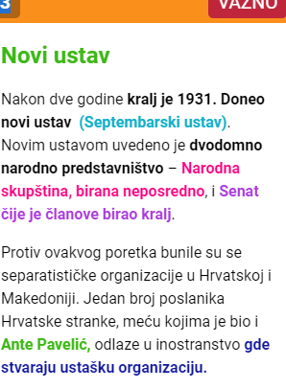
https://www.shtreber.com/kraljevina-jugoslavija

Slide 17
Conclusion
“Some nations imagined by intellectuals never took root; Czechoslovakia and Yugoslavia were just two cases” (p. 21).
Connelly, John. 2020. From Peoples into Nations: A History of Eastern Europe. Princeton & Oxford: Princeton University Press, 956

Slide 18
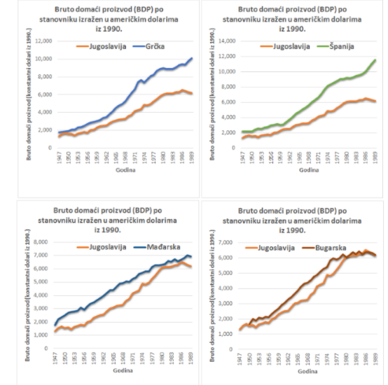
SFRJ 1945-1990.
7,4%
4,5%
8,3%
4,5%
Avrerage growth – 4,5%
Prices – from 1% do 313.000.000.000% monhly
Employment – 5-36%
Deficits – were they sustainable?
How high our growth?
3,3%
3,3%
4,5%
4,5%
Source: Ekonomija Titove Jugoslavije: odlaganje neminovnog kraha
BY PREDRAG RAJŠIĆ · PUBLISHED 24/02/2014 · UPDATED 06/07/2016

Slide 19
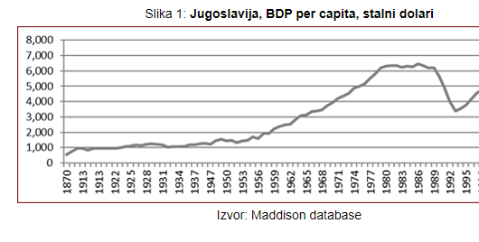
What is true about the economic growth?
Average annual GDP growth rate 1950-1990 ≈ 4,5%.
 | 1950 | 1990 | stopa rasta
Japan | 591 | 12840 | 10.81%
Austrija | 1108 | 9990 | 7.61%
Grčka | 430 | 3680 | 7.42%
Italija | 1022 | 8550 | 7.34%
Jugoslavija | 469 | 2300 | 4.5%
Turska | 389 | 1110 | 3.56%
Mađarska | 769 | 2020 | 3.27%
From 1952 to 1965, Yugoslavia witnessed the golden age of its economy, rivaling Japan as the fastest growing worldwide economy
Izvor: Šta je istina o privrednom rastu SFR Jugoslavije. MIJAT LAKIĆEVIĆ25/05/2019

Slide 20
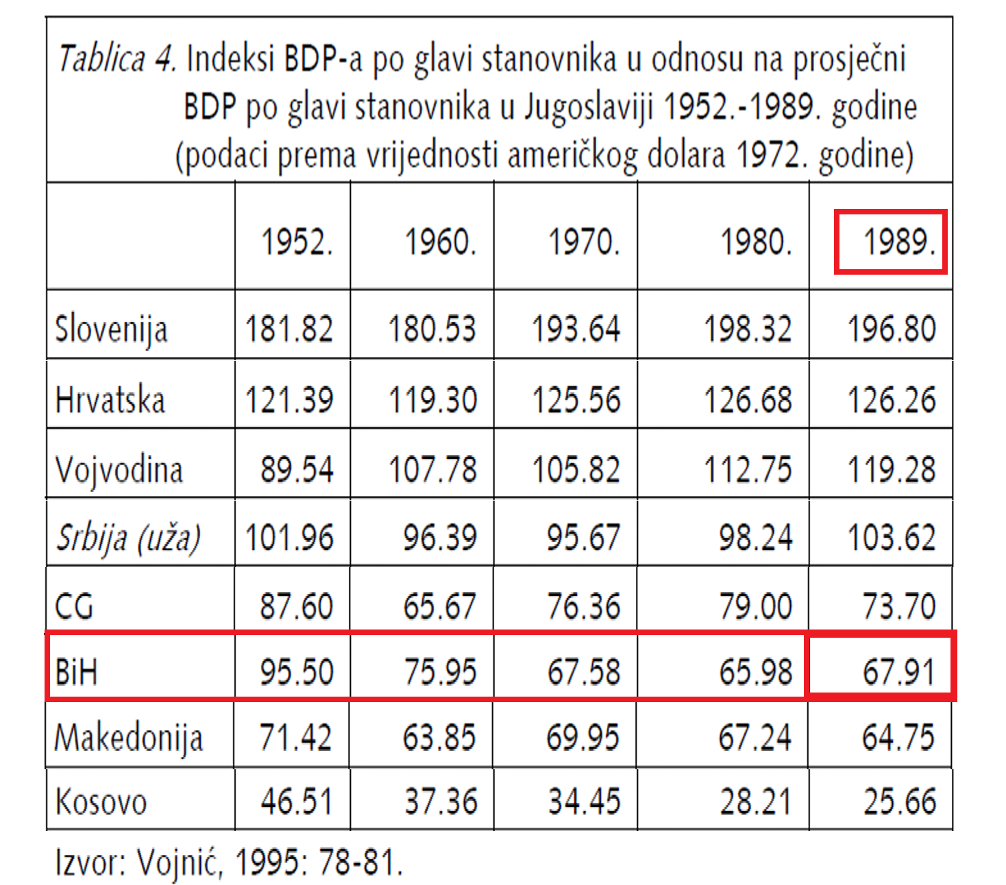

Slide 21
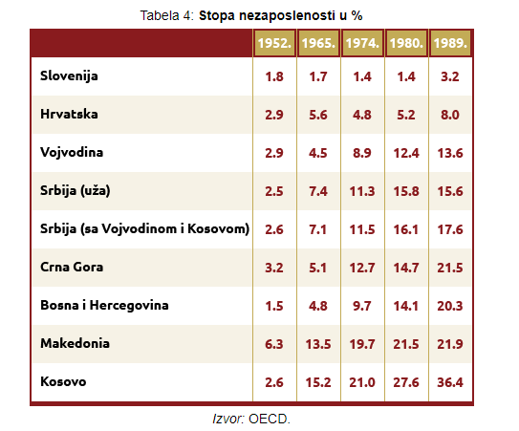
Employment
„NIJE TAČNO DA JE STATISTIKA DAVALA LAŽNE PODATKE, STATISTIKA JE DAVALA IZMIŠLJENE PODATKE“
The only solution for unemployment was to open the borders for emigration
^{This policy started as of 1965}
IZVOR – GLIGOROV, 2012

Slide 22
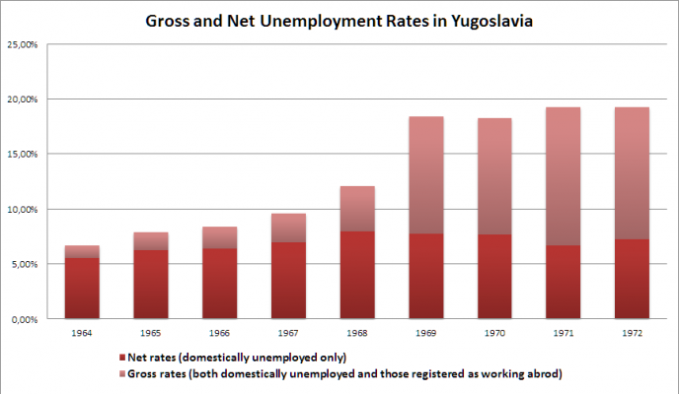
POLITIČKI PRIHVATLJIVA STOPA NEZAPOSLENOSTI JE < 10%
^{EMIGRACIJA}
^{DOZNAKE}

Slide 23
CRO
SER
World Bank Predicts Sharpest
Decline of Remittances in Recent history
BIH
MON
MAC
SLO

Slide 24
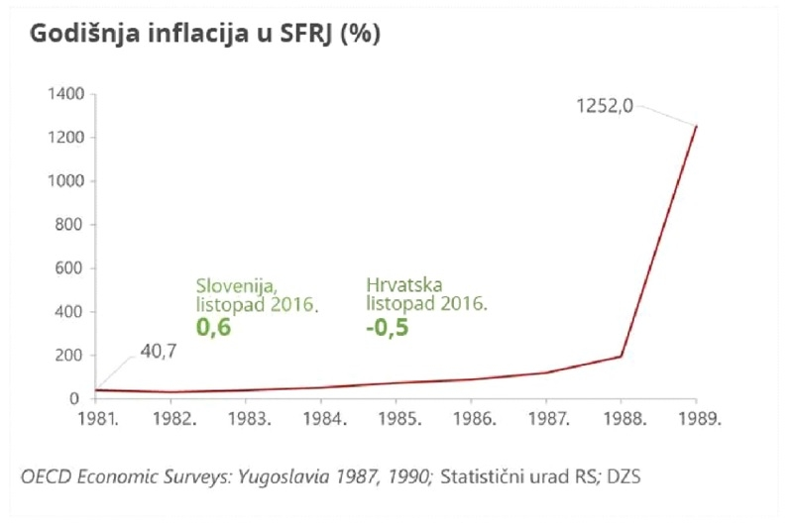
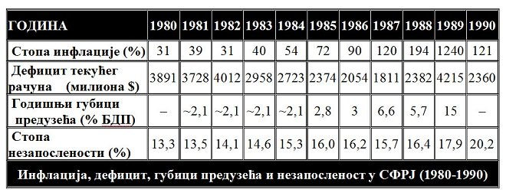
INFLACIJA - DENOMINACIJE
Табела 2. Инфлација, дефицит, губици предузећа и незапосленост у СФРЈ (1980-1990)
Извор: Хабул, 2017
Izvor: https://www.liberal.hr/jugoslavija-sfrj-gospodarstvo-mitovi-ex-yu-radnicko-samoupravljanje-508

Slide 25
Табела 4. Монетарни упади република у периоду октобар 1990. - фебруар 1991. Уп. Динкић, 2000.
Република | Износ
НБ Словеније | 1 милијарда динара
НБ Хрватске | 1,7 милијарда динара
НБ Србије (укључујући НБ Војводине и НБ Косова) | 21,7 милијарди динара (ДЕМ 3,1 милијарди)
НБ Црне Горе | 2.6 милијарди
НБ Македоније и НБ БиХ | користиле су у јануару 1991. незнатне износе "сивог новца”
The fact remains that Serbia made a monetary blow that was 20 times bigger than the one in Slovenia and ten times bigger than the one in Croatia. Although Markovic subsequently demanded sanctions for Serbia and insisted on the return of the money, none of that was implemented. That monetary blow formally labeled the end of Markovic's reforms and the beginning of the disintegration of Yugoslavia.

Slide 26
SPOLJNI DUG
1991 - $ 20 billion in debt. The debt was traded for 30 cents on the dollar, implying that it was considered unsustainable. 1990 – IMF reduced its debt by 1.8 billion because the country simply could not repay the interest, let alone the principal. 2/3 of the entire Yugoslav industry was operating at a loss,

Slide 27
Yugoslav economic reform in 1964
in the early 1960s there was stagnation and problems with servicing foreign loans
Due to that, in 1964, the Five-Year Plan 1961-1965 was rejeced
Great Economic Reform was announced in December 1964 in Belgrade.
The aim of the reform was
to introduce the law of supply and demand (market economy)
greater autonomy to businesses.
greater freedom to private capital (renewal of crafts and smaller economic plants).
Monetary reform, - the introduction of the real dinar exchange rate
(the goal was the convertible dinar), devalued from 750 to 1250 for 1 US $ (66.7%)
At the same time the denomination was carried out.
foreign trade was liberalized

Slide 28
the citizens of the SFRY were able to apply for and obtain a passport and travel wherever they wanted to the West, practically without any restrictions.
banking was also liberalized, - the first domestic commercial banks started operating, which started giving loans to citizens.
it soon began to show its negative side as well.
The number of unemployed has risen sharply,
the external debt suddenly began to swell,
social differences in society increased sharply –
so did political tensions (enterprise strikes, student revolt 1968, Croatian Spring, Kosovo).

Slide 29
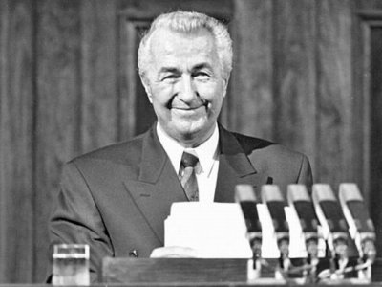
1950 – workers councils
1963 - Constitution reaffirmed that self-management and social property are the primary values ​​in all aspects of society.
1965 - reforms that meant the introduction of market mechanisms, creating the so-called market socialism.
1968 – Students protests
1974 - Constitution introduced the Basic Organization of Associated Labor (OOUR) - in which decisions were made through direct democracy.
1976 –The Labor Act all enterprises were broken down into OOURs,
Early 1980s -Austerity measures
1989 - the end of the system of self-government was declared in 1989 by Ante Markovic, the president of the Federal Executive Council, as "irrational divisions of labor and productivity"

Slide 30
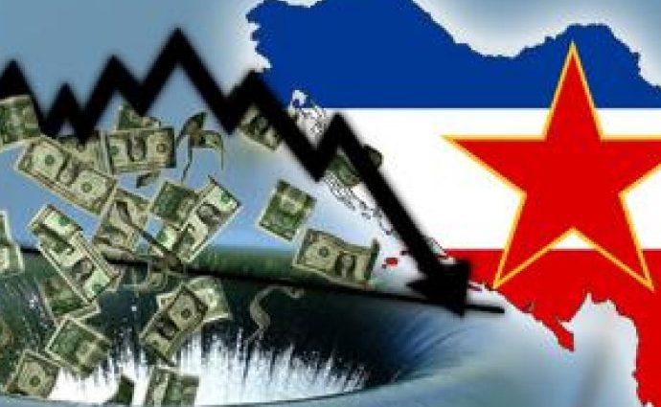
TWO STANCES:
EKONOMSKA SMRT JUGOSLAVIJE PRETHODILA JE POLITIČKOJ ON: 19. APRILA 2016. Danijal Hadžović Politički se kolaps se nije mogao sprečiti, ali ekonomski bi se isplatilo sačuvati Jugoslaviju, ističe Holzner sa Bečkog instituta za međunarodne ekonomske studije (WIIW) u intervjuu za APA-u.
Be that as it may:
Kraj 1990. Jugoslavija je dočekala s padom BDP-a od čitavnih 11,6%.
Stranka Ante Marković ni u jednoj republici na izborima nije uspjela osvojiti dvocifren procenat glasova.
:

Slide 31
“What is astounding is how quickly the recognition dawned that the new ‘Yugoslav’ and ‘Czechoslovak’ peoples were semi-fictions” (p. 343).
Connelly, John. 2020. From Peoples into Nations: A History of Eastern Europe. Princeton & Oxford: Princeton University Press, 956.
Much more is needed that the idea of well-wishing intellectual to build the nation. The author rightly emphasises the huge ethnical/cultural heterogeneity of South Slavs now united in their own independent state. Perhaps that can explain the failure of Yugoslavia project with its two distinctive stages ̶ nothing (politically) worked.

Slide 32
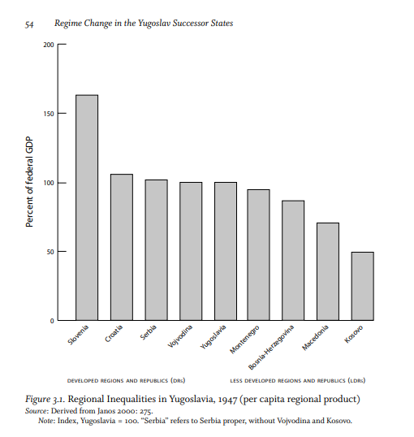

Slide 33
Literatura
New Economic History of Yugoslavia, 1919 - 1939: Industrial Location, Market Integration and Financial Crises. University of York Economics September, 2016
Cicvarić, A., 1992: Korijeni i recidivi dogovorne ekonomije. Ante Cicvarić, Zagreb, p. 84
Bicanic, Rudolf, 1973, Economic Policy in Socialist Yugoslavia, Cambridge
Branko Hinić, Ljiljana Đurđević and Milan Šojić, National Bank of SerbiaSerbia/Yugoslavia: from 1884 to 1940
Mijatović, Boško (2010), ‘Economic policy and conjuncture in Yugoslavia 1919–1925’, Center for Liberal-Democratic Studies, Working Document (in Serbian).
Gnjatović, Dragana, 2016. DUŽNIČKI TERET KRALJEVINE JUGOSLAVIJE U VREME VELIKE SVETSKE EKONOMSKE KRIZE
Lakićević, Mijat, 2019, Šta je istina o privrednom rastu SFR Jugoslavije, MIJAT LAKIĆEVIĆ, Peščanik 25/05/2019
Gligorov, Jugoslavija i razvoj: korist i troškovi ključna tema sporenja
Dr. IVAN MANDIĆ, Ekonomski fakultet Osijek, Društveno-ekonomski razvoj i zaposlenost, EKONOMSKI VJESNIK, 2 (1): 107—116 1989.
Boduszyński, Mieczysław P. Regime Change in th,e Yugoslav Successor States: Divergent Paths toward a New Europe. Johns Hopkins University Press, 2010.
Foreign Exchange Policy in the Kingdom of Yugoslavia during and after the Great Depression Dragana Gnjatović Megatrend University, Belgrade
Jevtic, Aleksandar R. Working Paper Gold rush: The political economy of gold standard adoption in the Kingdom of Yugoslavia
Branko Pavlica, 2005, MIGRACIJE IZ JUGOSLAVIJE U NEMAČKU – MIGRANTI, EMIGRANTI, IZBEGLICE, AZILANTI
Connelly, John. 2020. From Peoples into Nations: A History of Eastern Europe. Princeton & Oxford: Princeton University Press, 956.
https://miltonfriedman.hoover.org/objects/52216/report-on-yugoslavia-and-italy
PREDRAG RAJŠIĆ, 2016 Ekonomija Titove Jugoslavije: odlaganje neminovnog kraha, Katalaksija
Danijal HADŽOVIĆ. 2016, EKONOMSKA SMRT JUGOSLAVIJE PRETHODILA JE POLITIČKOJ
P. H. Liotta., 2001 Paradigm Lost :Yugoslav Self-Management and the Economics of Disaster, Balkanologie Revue d'études pluridisciplinaires Vol. V, n° 1-2 | 2001

